Slide 1
Chisel and FIRRTL for next-generation SoC designs
Jack Koenig SiFive CWG TAC Member

Slide 2
Introduction
What is the Chisel Working Group (CWG)?

Slide 3
What is Chisel?
Constructing Hardware In a Scala Embedded Language
Domain Specific Language where the domain is digital design
NOT high-level synthesis (HLS) nor behavioral synthesis
Write Scala program to construct and connect hardware objects
Parameterized types
Object-Oriented Programming
Functional Programming
Static Typing w/ Powerful Type Inference
Intended for writing reusable hardware generators (libraries)

Slide 4
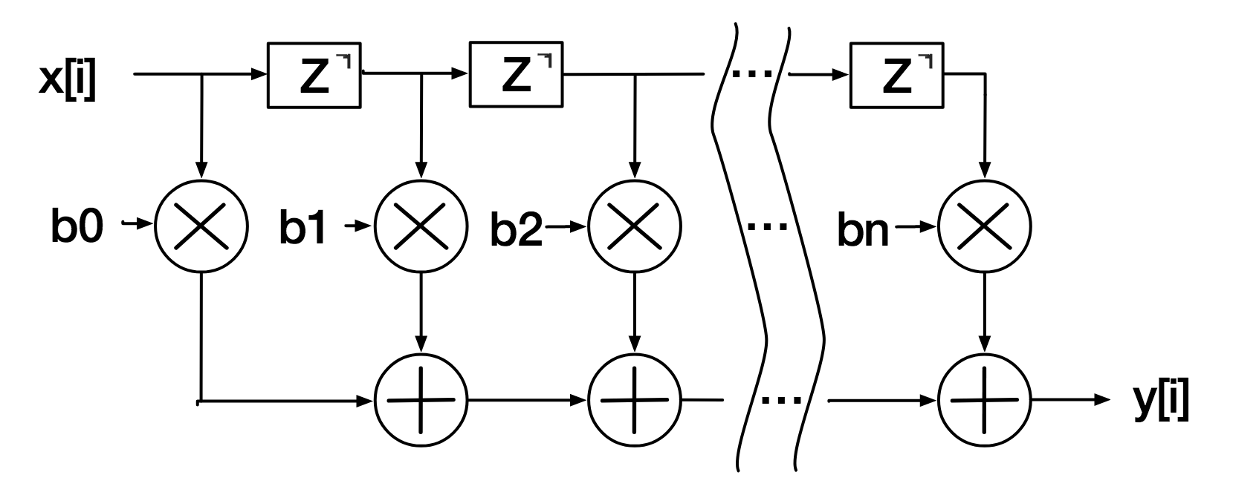
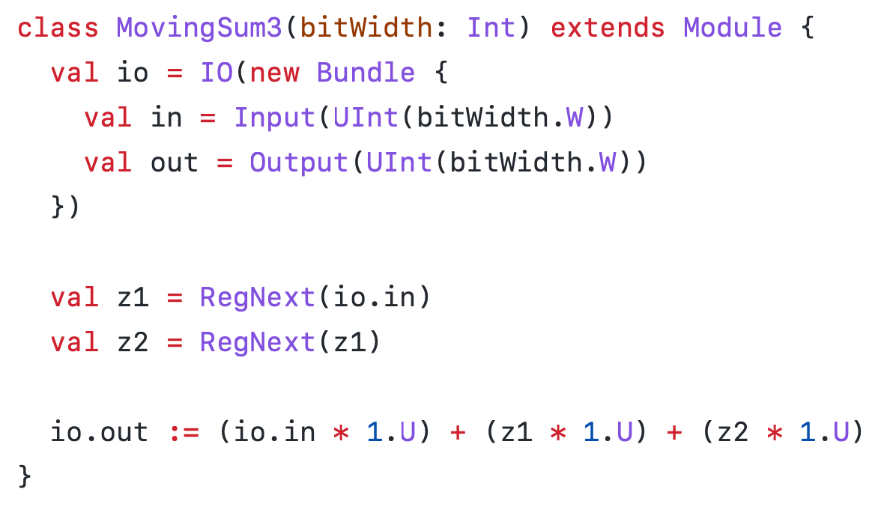
No Loss of Expressibility: “Verilog-like” Chisel
FIR Filter - 3-point moving sum
What about >3 points? What about weighted averages?
We want a generic FIR filter!
Notes:
You may notice a few differences from Verilog
No explicit clock or reset?
Common case of single clock/reset domain is easy, more control also available

Slide 5
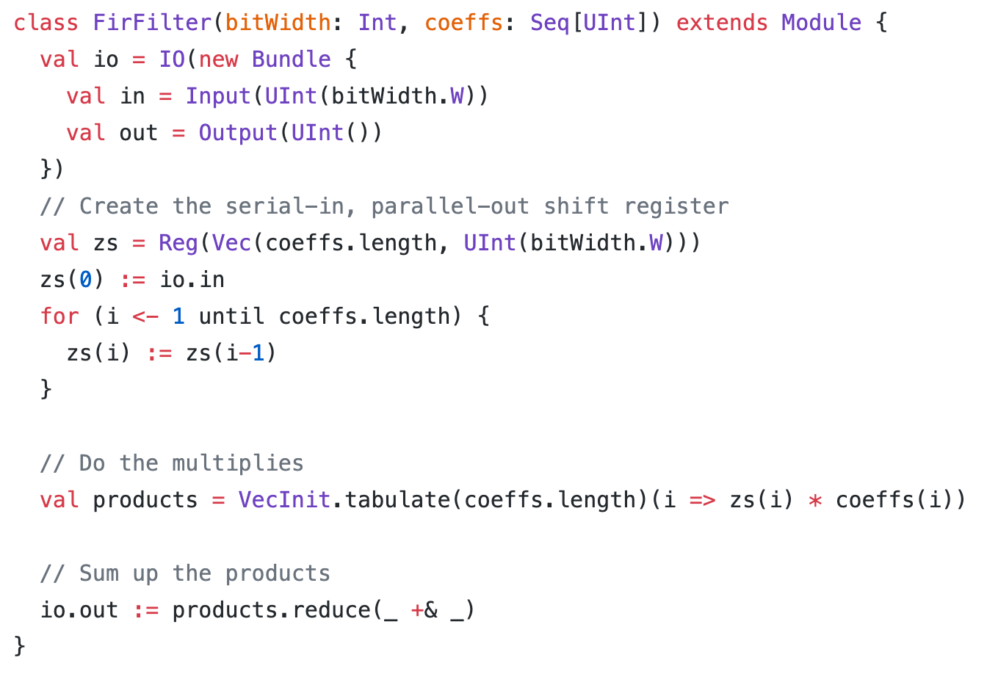
Massive Increase in Parameterizability: “Software-like” Chisel
FIR Filter - Parameterized by bitwidth and coeffients with no loss of expressibility or performance.
Meta-programming enables powerful parameterization.

Slide 6
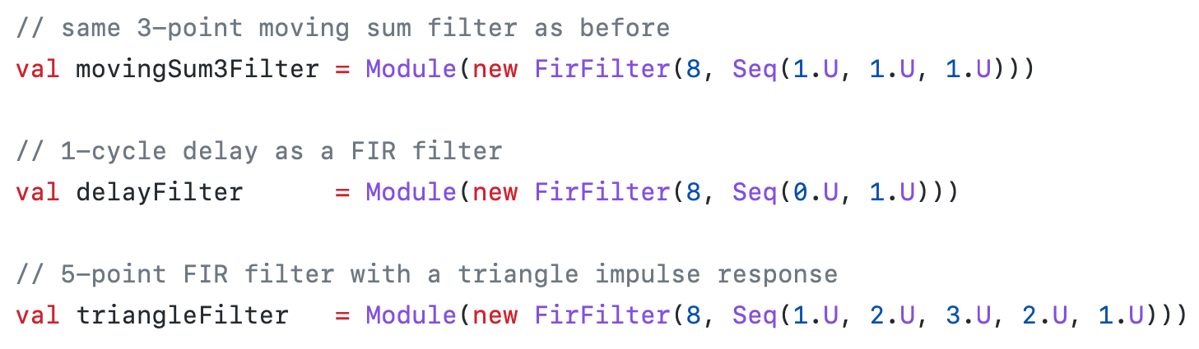
Massive Increase in Parameterizability: “Software-like” Chisel
FIR Filter - Parameterized by bitwidth and coeffients with no loss of expressibility or performance.
Meta-programming enables powerful parameterization.

Slide 7
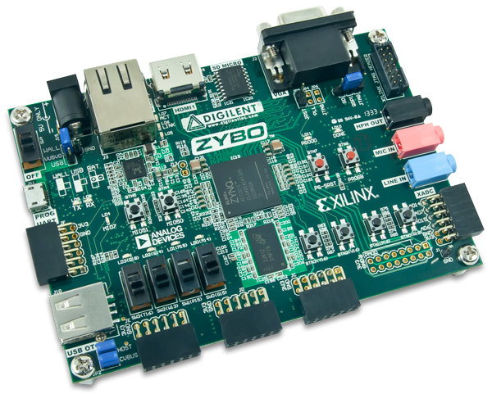
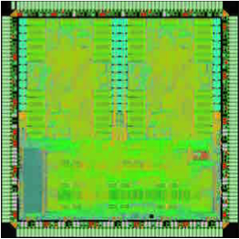
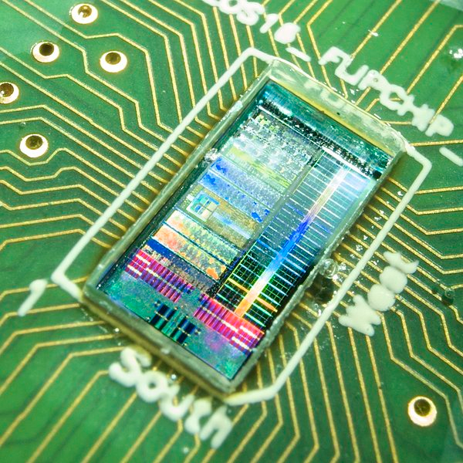
Platform-Specific or Application-Specific RTL Changes
Chip RTL
+ scan interface
+ snapshotting
+ interactive debug
+ SRAM macros
+ modified module hierarchy
+ specialized layout
+ clock-generators
+ SRAMs with init
+ specialized layout
Zynq FPGA
ST 28nm FDSOI
IBM 45nm SOI

Slide 8



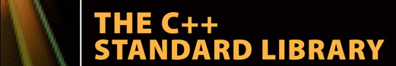




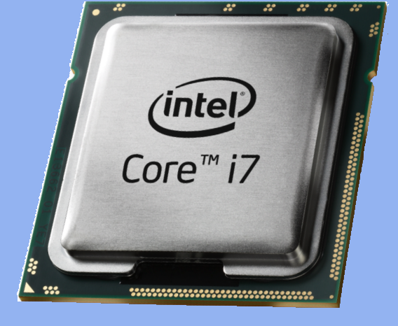
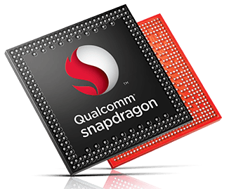
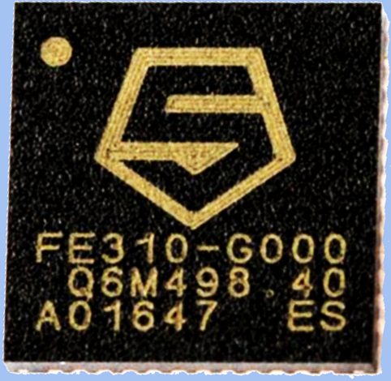

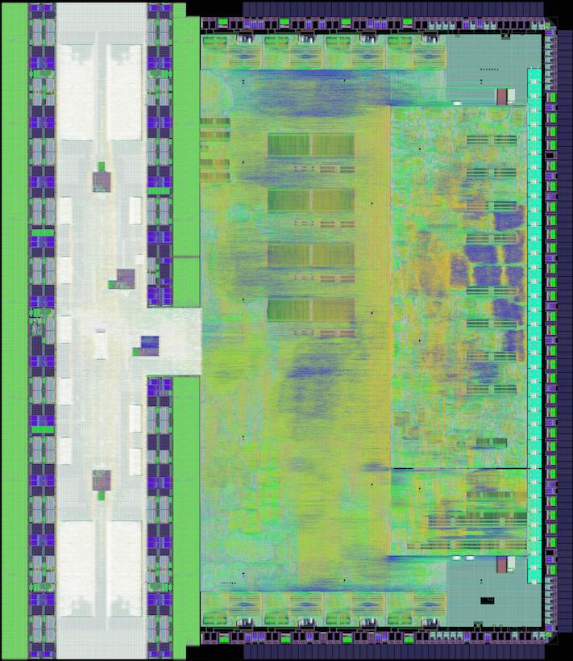



Realization: We need a software stack, but for hardware
projects
BOOM
Rocket
Hwacha
libraries
rocketchip
chisel-utils
language
compiler
clang
Chisel Frontend
transforms
FIRRTL
x86
ARM
RISC-V
platforms
Notes:
Reminder that Aliaksei pointed out that we emit Verilog and there’s “the rest of the owl” beneath that (unlike what LLVM emits), important shout outs to Verilator, Open FPGA and OpenROAD for doing the hard work of making Verilog useful.

Slide 9
FIRRTL: An Extensible Hardware Compiler Framework
Core
Transform
Custom
Transform
Top
Top
Top
MyMux
MyMux
MyMux
...
...
...
...
...
...
Metadata
Metadata
Metadata
Annotations
Annotations
Annotations
Modular Compiler Passes (Transforms)
Robust Metadata/Annotations Support

Slide 10
Projects of the Chisel Working Group
Chisel 3
FIRRTL
ChiselTest (formerly Chisel Testers 2)
Treadle
Chisel Bootcamp
Chisel Template
Chisel IOTesters
DSP Tools
Diagrammer

Slide 11
Highlights

Slide 12
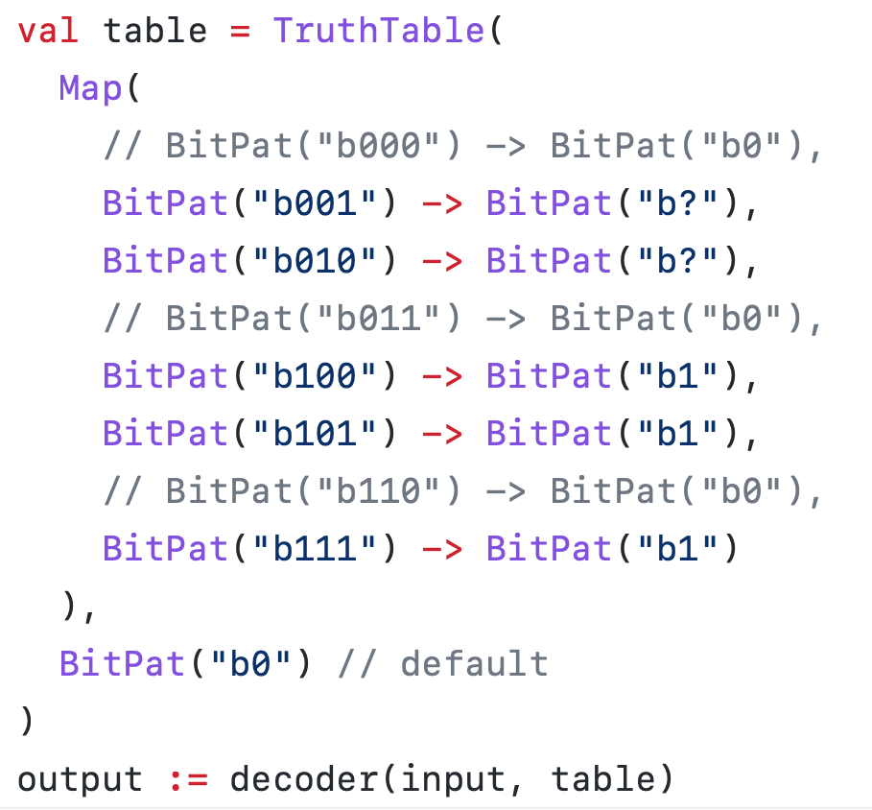

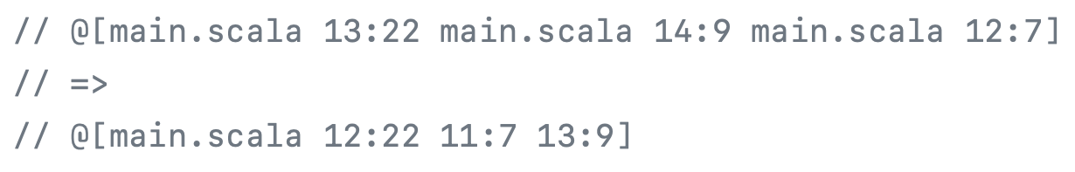
Chisel v3.5.0 – v3.5.2 Released!
Lightning Highlights
Vec literal support
Scala 2.13 support (2.11 EOL)
Decoder + minimizer API in chisel3.util (w/ Espresso integration)
Source locator compacting
Many performance improvements
Chisel ~40-50% faster, FIRRTL ~20% faster
New Utilities – Gray code, scanLeftOr
RTL-IL backend
See release notes on Github!

Slide 13

Chisel v3.5.0 – v3.5.2 Released!
Lightning Highlights
Vec literal support
Scala 2.13 support (2.11 EOL)
Decoder + minimizer API in chisel3.util (w/ Espresso integration)
Source locator compacting
Many performance improvements
Chisel ~40-50% faster, FIRRTL ~20% faster
New Utilities – Gray code, scanLeftOr
RTL-IL backend
Digital Design with Chisel 3rd ed. by Martin Schoeberl
https://www.imm.dtu.dk/~masca/chisel-book.html
Also in Chinese, Japanese, and Vietnamese!
See release notes on Github!

Slide 14
ChiselTest Improvements
Simpler peek/poke with Scala types
Improved Verilator simulation performance via JNA
Verilator backend now supports dumping FST instead of VCD
PeekPokeTester compatibility API
Helps migrate users off old chisel-iotesters
Simulation constructs can now be annotated
assert/assume/cover graduated out of experimental
Simulation binary caching
Support for bounded model checking (next slide)

Slide 15
Native Formal Verification Support
Formal verification is assumed to be difficult for users
Good tooling and sensible defaults can help
Similar to simulator-based flow
Safe past function
Automatic reset guarding (default but disableable)
Close integration with simulation testing flow
Same basic APIs
Same IDE and tooling integration
Automatically runs counter examples through a simulator to provide a waveform
Native FIRRTL -> SMTLib or btor2 output
Works with Z3 and CVC4
See Kevin Laeufer’s WOSET Paper https://woset-workshop.github.io/WOSET2021.html#article-3

Slide 16
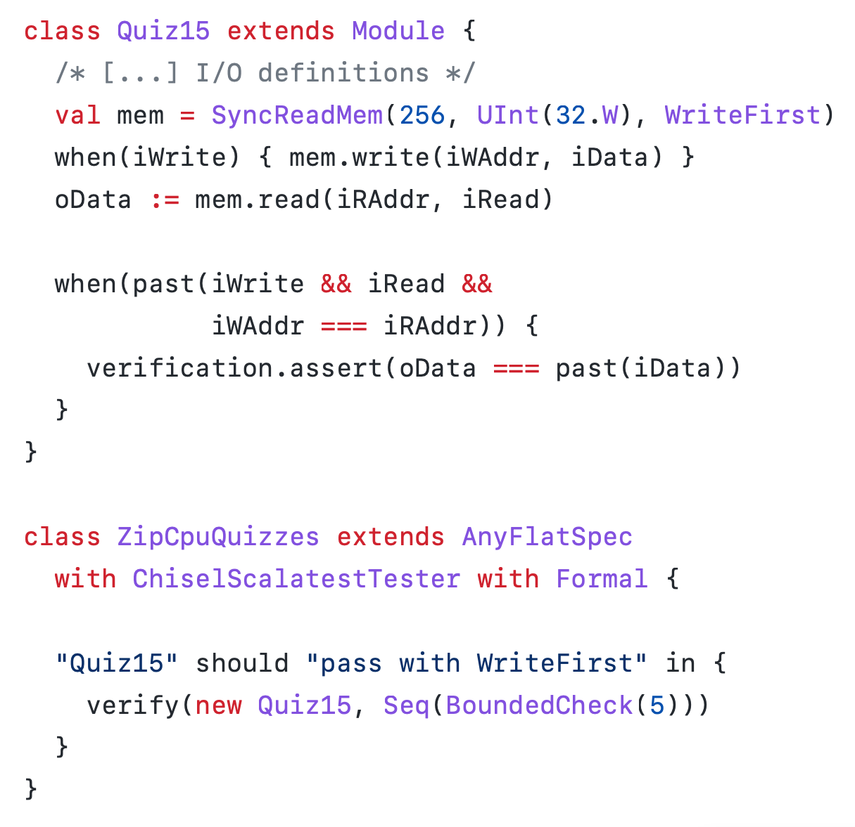
Native Formal Verification Support
Formal verification is assumed to be difficult for users
Good tooling and sensible defaults can help
Similar to simulator-based flow
Safe past function
Automatic reset guarding (default but disableable)
Close integration with simulation testing flow
Same basic APIs
Same IDE and tooling integration
Automatically runs counter examples through a simulator to provide a waveform
Native FIRRTL -> SMTLib or btor2 output
Works with Z3 and CVC4
See Kevin Laeufer’s WOSET Paper https://woset-workshop.github.io/WOSET2021.html#article-3
Notes:
This example verifies that when a Chisel memory with synchronous read port and WriteFirst behavior has a read and a write access to the same address, the new value will be returned. The check fails if WriteFirst is substituted with ReadFirst or Undefined (Section IV). It is based on a Verilog example from a popular blog. In the Chisel version, the assertion is automatically delayed until at least one cycle after reset, when there are valid past values available (Section VI). A bounded model check is executed by the verify command, which is called from a standard Scala unit test (Section III). When the check fails, the failing inputs and starting states are replayed on a simulator, resulting in a waveform file that is identical to the output we would get from a dynamic verification run. However, since we used bounded model checking to find the failing trace, it will be as short as possible. In our example, two cycles after reset are needed to fail the property. The first cycle contains the read and write requests and the second cycle observes the arbitrary result on the read port if we set the memory behavior to Undefined for read/write conflicts. The included screenshot was obtained with the open-source GTKWave waveform viewer.

Slide 17
Definition / Instance
Historically, Chisel elaborates every module instance and then deduplicates structurally equivalent modules
New experimental API for definining (and elaborating) a module once and instantiating multiple times
Definition – Elaborates implementation of module
Instance – Merely instantiates public API
Major performance optimization for very large or hierarchical designs
Composes with cross-module reference annotations
Experimental – undergoing active development
See https://www.chisel-lang.org/chisel3/docs/cookbooks/hierarchy.html for docs
Notes:
Why is this complicated? What is a public API?

Slide 18
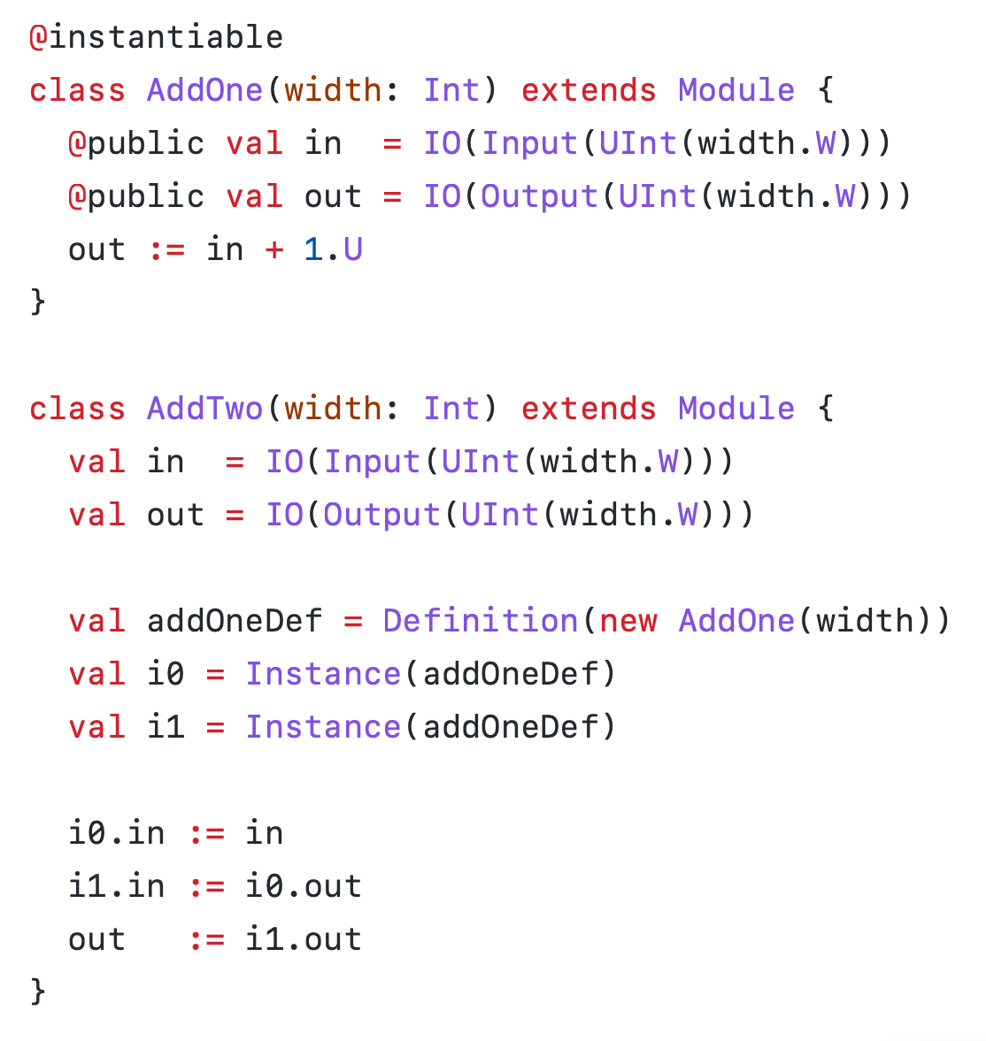
Definition / Instance
Historically, Chisel elaborates every module instance and then deduplicates structurally equivalent modules
New experimental API for definining (and elaborating) a module once and instantiating multiple times
Definition – Elaborates implementation of module
Instance – Merely instantiates public API
Major performance optimization for very large or hierarchical designs
Composes with cross-module reference annotations
Experimental – undergoing active development
See https://www.chisel-lang.org/chisel3/docs/cookbooks/hierarchy.html for docs
Notes:
Why is this complicated? What is a public API?

Slide 19
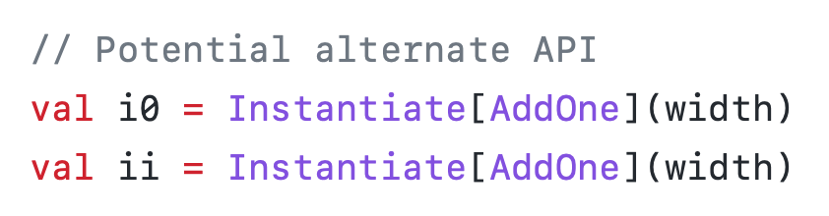
Definition / Instance
Historically, Chisel elaborates every module instance and then deduplicates structurally equivalent modules
New experimental API for definining (and elaborating) a module once and instantiating multiple times
Definition – Elaborates implementation of module
Instance – Merely instantiates public API
Major performance optimization for very large or hierarchical designs
Composes with cross-module reference annotations
Experimental – undergoing active development
See https://www.chisel-lang.org/chisel3/docs/cookbooks/hierarchy.html for docs
Notes:
Why is this complicated? What is a public API?

Slide 20
DataView
Often users want to manipulate hardware values as if they were a different type
AXI-style flat bus interface used as more structured hierarchy
Allows treating objects of one type as another
A superpowered union or cast, like View in SQL
Used to implement:
See https://www.chisel-lang.org/chisel3/docs/explanations/dataview.html for docs

Slide 21
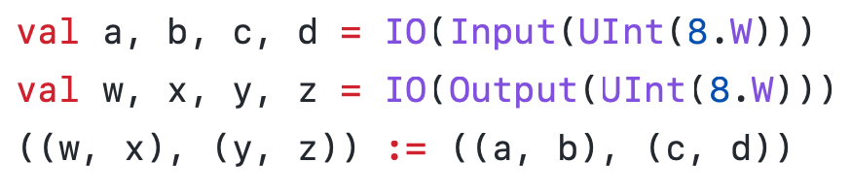
DataView
Often users want to manipulate hardware values as if they were a different type
AXI-style flat bus interface used as more structured hierarchy
Allows treating objects of one type as another
A superpowered union or cast, like View in SQL
Used to implement:
Seamless integration with Scala types
See https://www.chisel-lang.org/chisel3/docs/explanations/dataview.html for docs

Slide 22
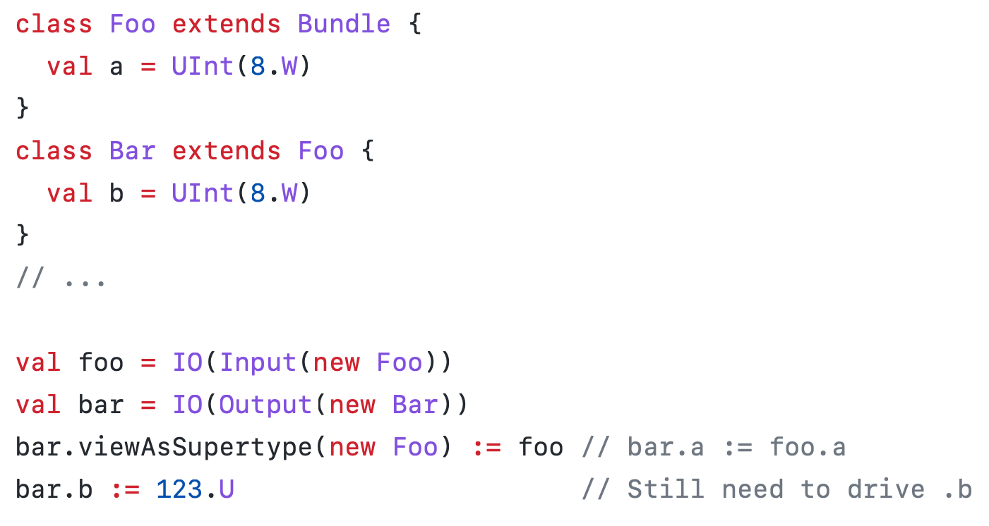
DataView
Often users want to manipulate hardware values as if they were a different type
AXI-style flat bus interface used as more structured hierarchy
Allows treating objects of one type as another
A superpowered union or cast, like View in SQL
Used to implement:
Seamless integration with Scala types
Bundle upcasting
See https://www.chisel-lang.org/chisel3/docs/explanations/dataview.html for docs

Slide 23
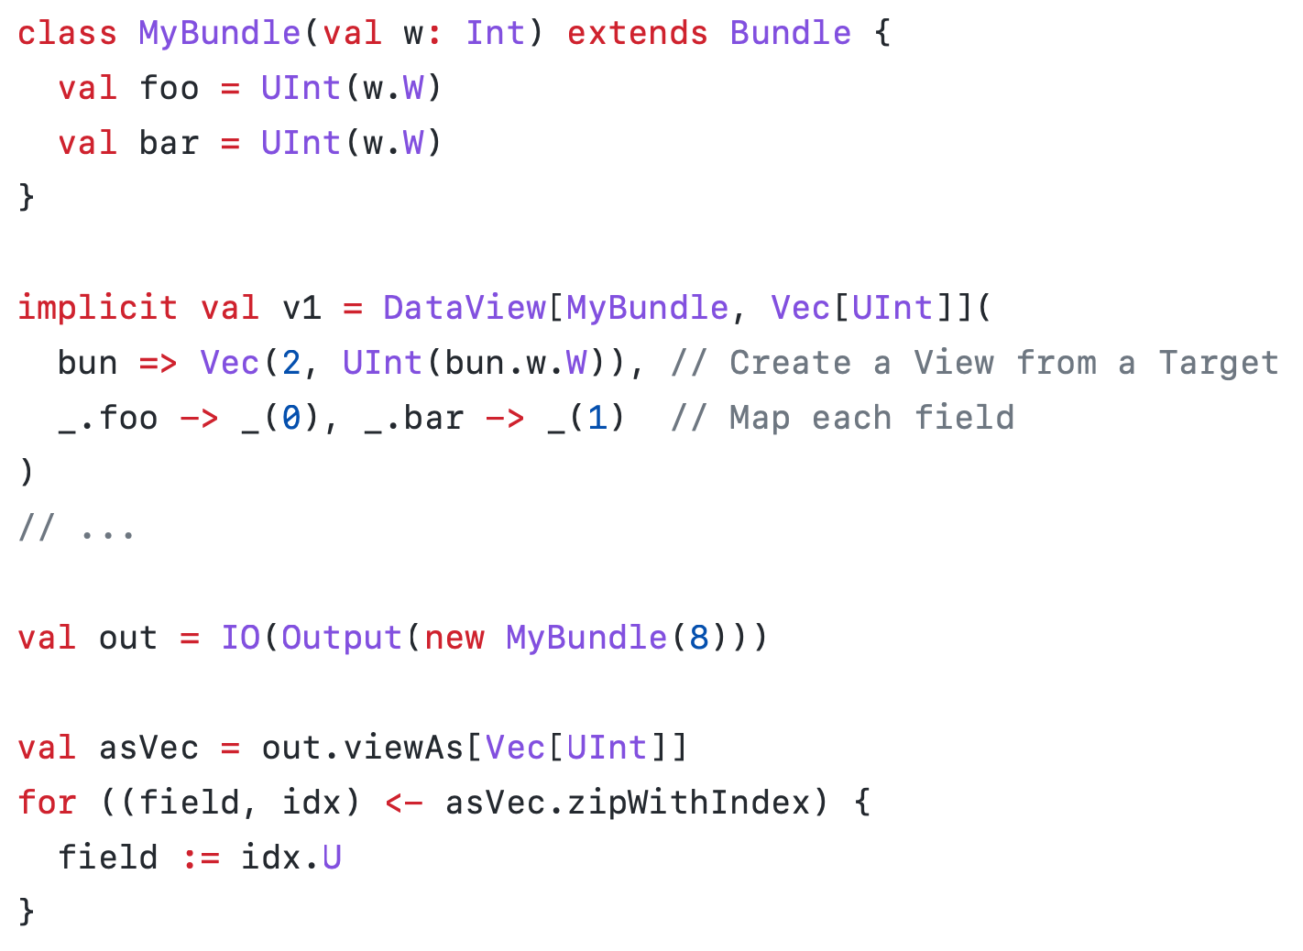
DataView
Often users want to manipulate hardware values as if they were a different type
AXI-style flat bus interface used as more structured hierarchy
Allows treating objects of one type as another
A superpowered union or cast, like View in SQL
Used to implement:
Seamless integration with Scala types
Bundle upcasting
User-defined mappings between types
See https://www.chisel-lang.org/chisel3/docs/explanations/dataview.html for docs

Slide 24
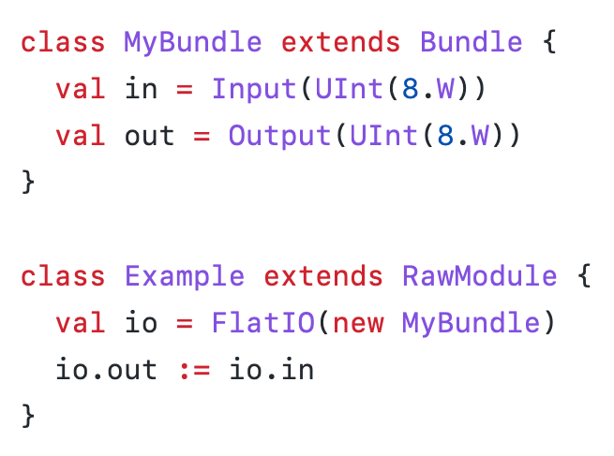
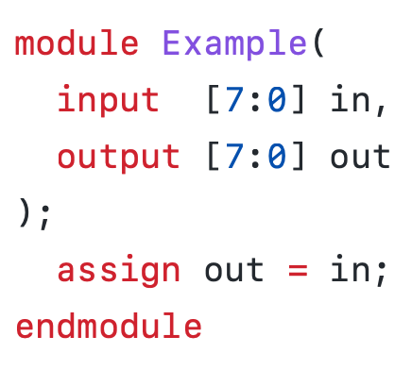
DataView
New in 3.5.3
Often users want to manipulate hardware values as if they were a different type
AXI-style flat bus interface used as more structured hierarchy
Allows treating objects of one type as another
A superpowered union or cast, like View in SQL
Used to implement:
Seamless integration with Scala types
Bundle upcasting
User-defined mappings between types
Strip io_ prefix
See https://www.chisel-lang.org/chisel3/docs/explanations/dataview.html for docs

Slide 25

Realization: We need a software stack, but for hardware
projects
BOOM
Rocket
Hwacha
libraries
rocketchip
chisel-utils
language
compiler
clang
Chisel Frontend
transforms
FIRRTL
x86
ARM
RISC-V
platforms
Notes:
Reminder that Aliaksei pointed out that we emit Verilog and there’s “the rest of the owl” beneath that (unlike what LLVM emits), important shout outs to Verilator, Open FPGA and OpenROAD for doing the hard work of making Verilog useful.

Slide 26


It is a lot of work to build and maintain a software stack
projects
BOOM
Rocket
Hwacha
libraries
rocketchip
chisel-utils
language
Custom
Infrastructure
compiler
Metadata /
Annotations
clang
Chisel Frontend
transforms
FIRRTL
x86
ARM
RISC-V
platforms
Notes:
Reminder that Aliaksei pointed out that we emit Verilog and there’s “the rest of the owl” beneath that (unlike what LLVM emits), important shout outs to Verilator, Open FPGA and OpenROAD for doing the hard work of making Verilog useful.

Slide 27


It is a lot of work to build and maintain a software stack
projects
BOOM
Rocket
Hwacha
libraries
rocketchip
chisel-utils
language
Custom
Infrastructure
Shared
Infrastructure
compiler
Metadata /
Annotations
clang
Chisel Frontend
Multiple
Dialects
CIRCT
transforms
FIRRTL
x86
ARM
RISC-V
platforms
Notes:
Reminder that Aliaksei pointed out that we emit Verilog and there’s “the rest of the owl” beneath that (unlike what LLVM emits), important shout outs to Verilator, Open FPGA and OpenROAD for doing the hard work of making Verilog useful.

Slide 28

What is MLIR?
“Multi-Level IR”
A generalization of LLVM
Part of the LLVM project
Infrastructure for building new compilers
Suitable for building new IRs
Can handle multiple IRs at once
Written in C++
Extremely performant

Slide 29
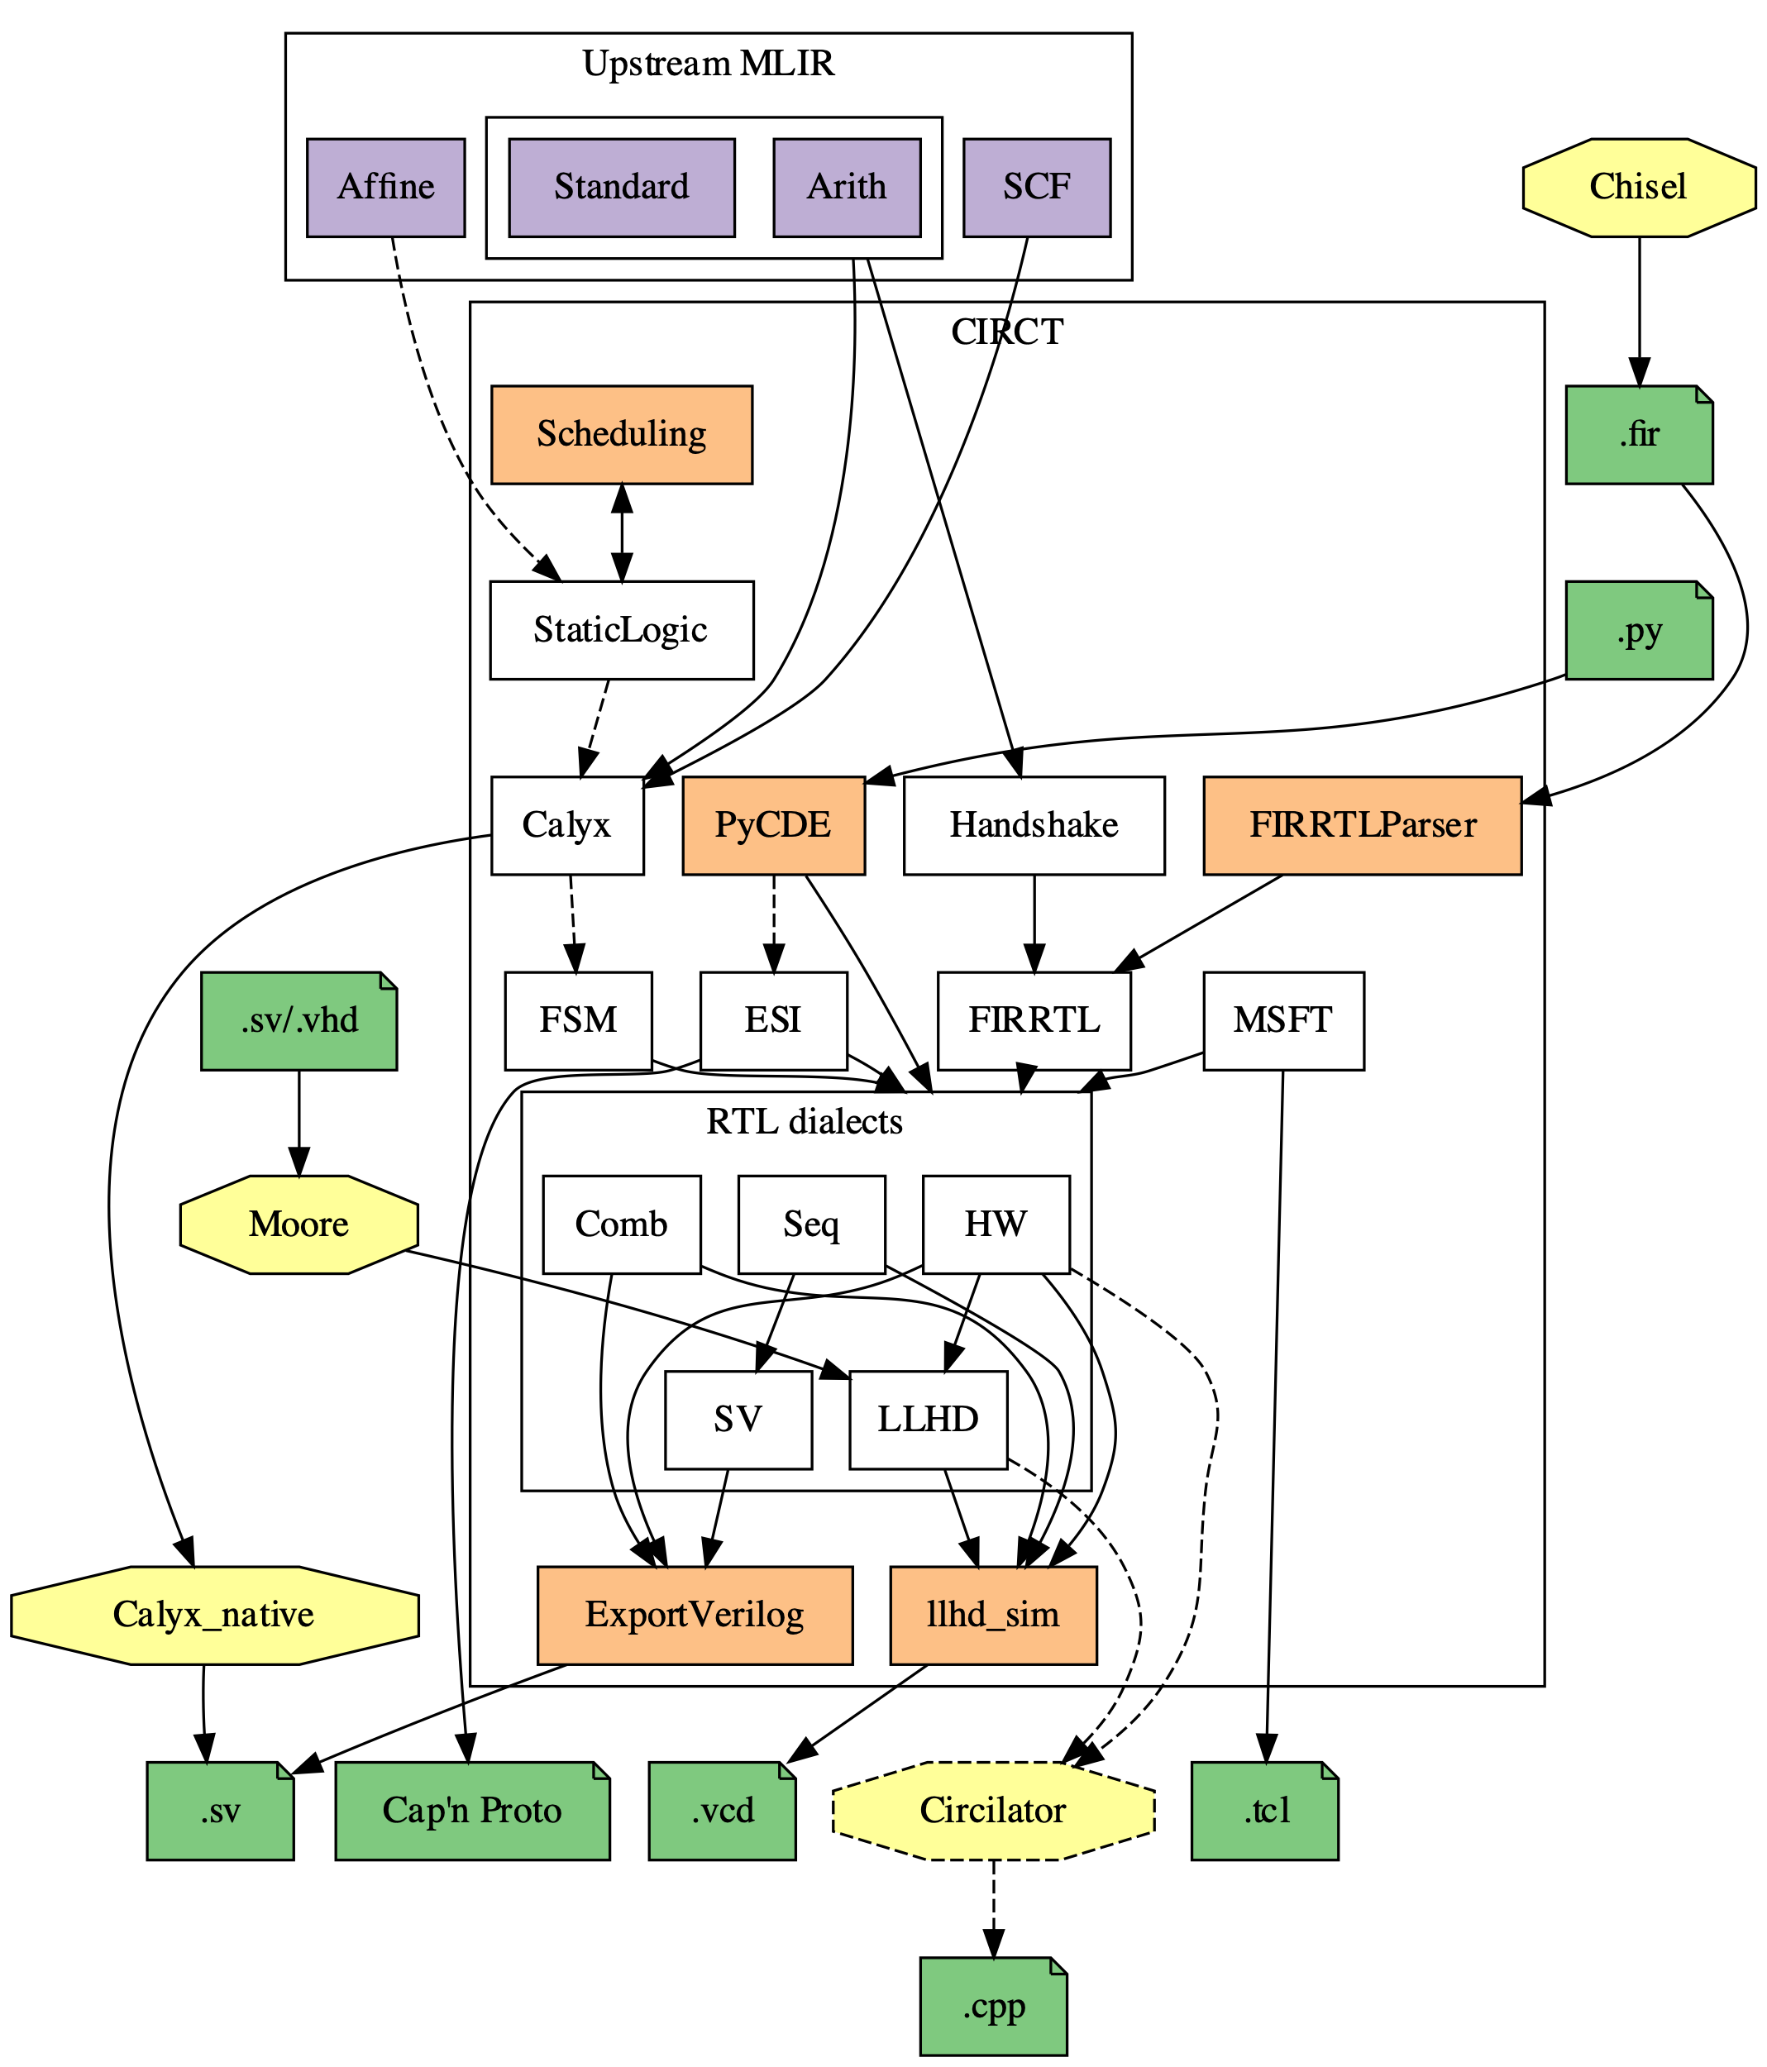
CIRCT: Circuit IR for Compilers and Tools
What is CIRCT (pronounced “circuit”)?
An LLVM incubator project
Compiler infrastructure for generating Verilog
A collection of hardware dialects
FIRRTL Dialect
SystemVerilog Dialect*
RTL Dialects
Combinational
Sequential
Hardware
Timing Insensitive Dialects
Elastic Silicon Interconnect (ESI)
Handshake
A collection of tools for compiling circuits
e.g., firtool is a drop in replacement for firrtl

Slide 30
What does this mean for Chisel?
Next generation FIRRTL compiler
Faster compilation (5-10x)
Less memory (5-10x)
Better Verilog emission
Robust platform for new features
Starting in Chisel 3.6
Built-in support for CIRCT
Starting in Chisel 3.7
Closer integration with CIRCT
CIRCT-first features
7.6x
4.3x
1.9x
Notes:
Combined 4.3x

Slide 31
Community

Slide 32
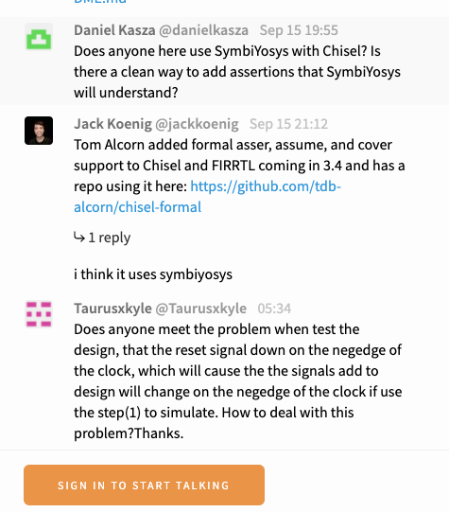
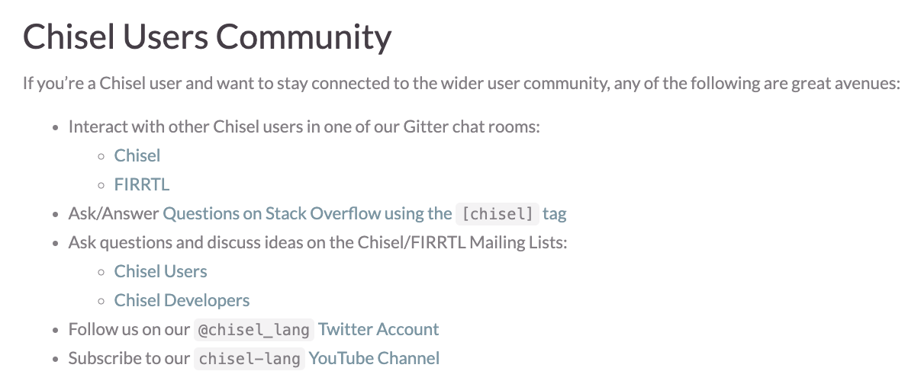
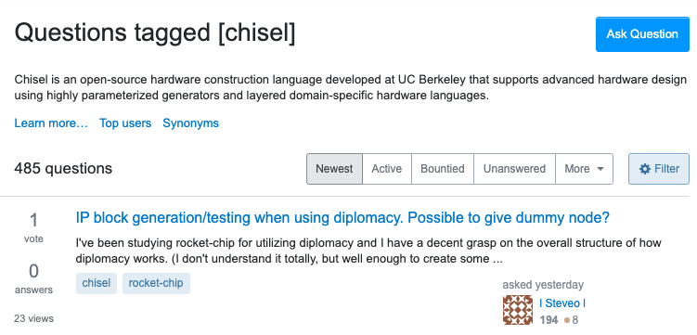
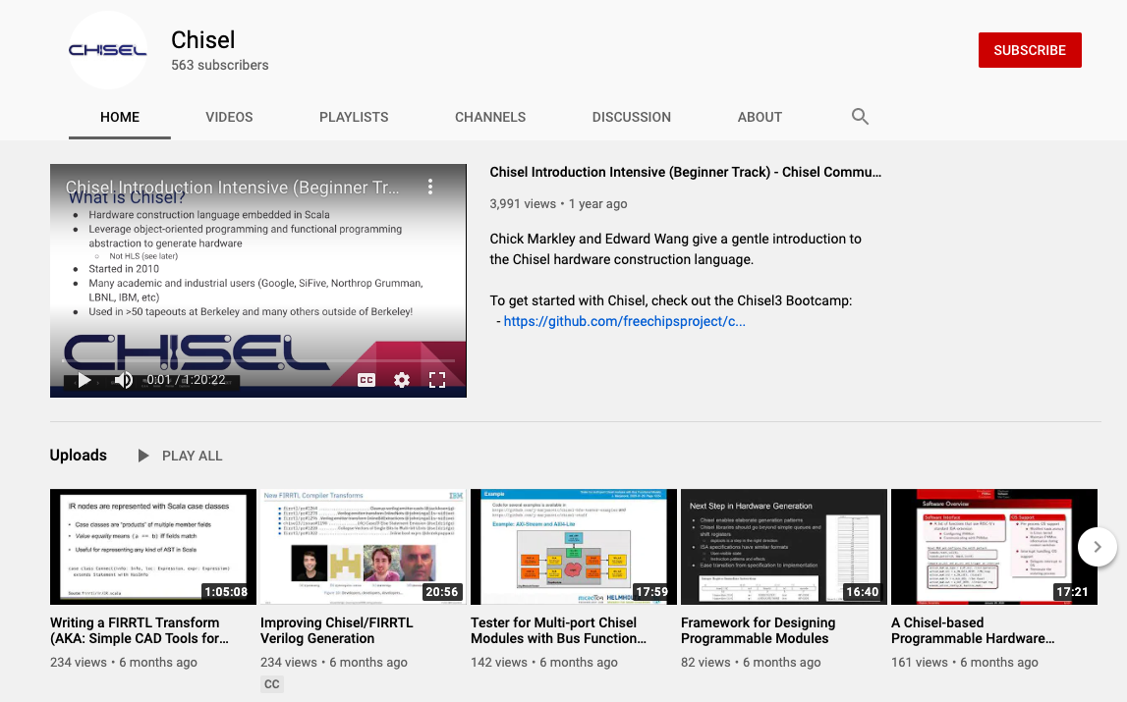
Get Involved
www.chisel-lang.org
Chat with us on Gitter
Ask questions on StackOverflow
Also check out CIRCT
Watch talks on YouTube
circt.llvm.org

Slide 33
Extra / Old Slides

Slide 34
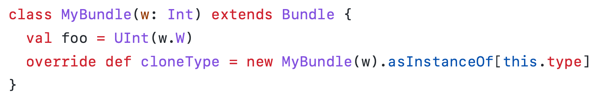
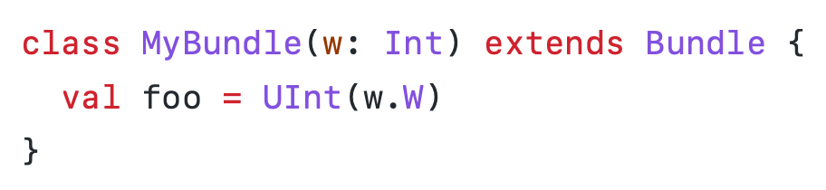
AutoCloneType2
Before:
cloneType is an implementation detail that leaks into the user API (since original Chisel)
Useless boilerplate
Original AutoCloneType works okay but has some limitations
Parameters must be defined as “vals”
Works in typical use cases but not all use cases
Slow
The Chisel compiler plugin now generates cloneType for all Bundles
Available in Chisel v3.4.3 (opt-in)
Improved in v3.4.4
Mandatory in v3.5.0
After:
Notes:
I told you about this last time but there’s just _more_

Slide 35
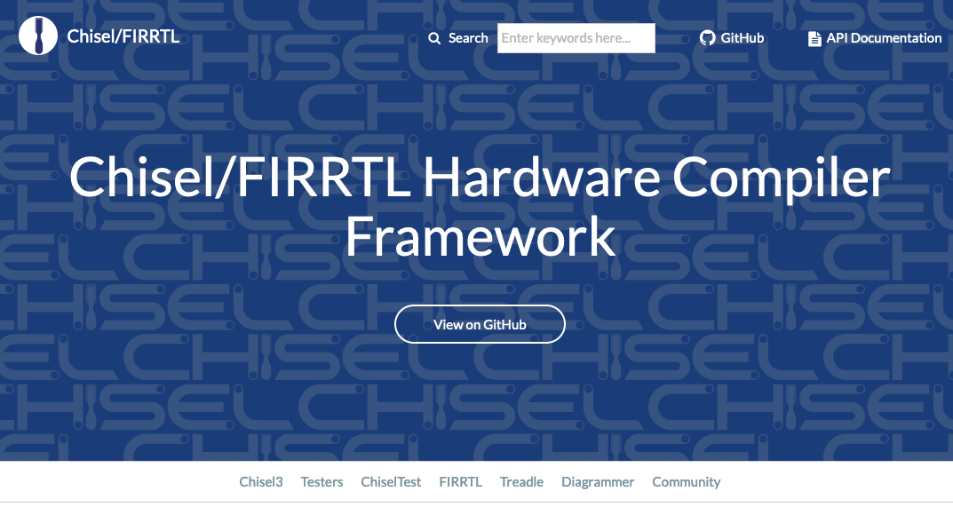
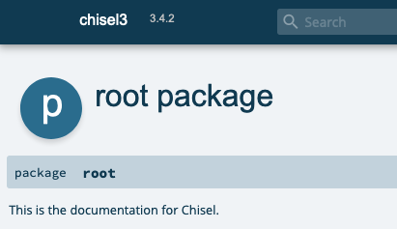
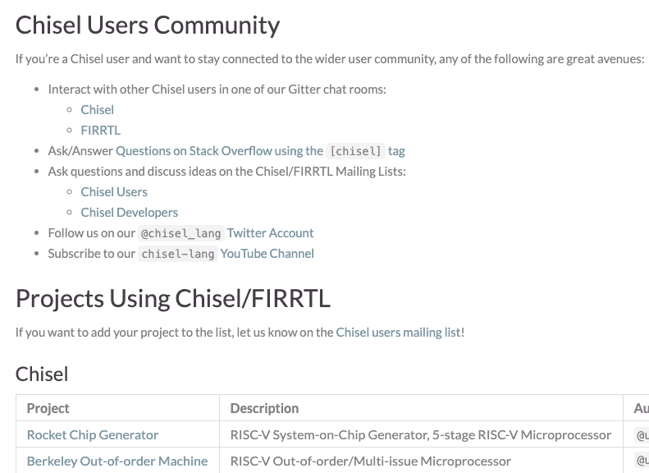
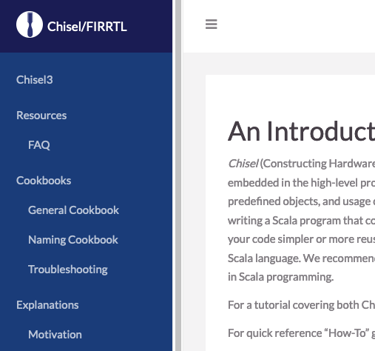
Further Improved Website
www.chisel-lang.org
Now with a search bar!
Latest API Docs
Project-specific documentation
Community page
35
4/19/22

Slide 36
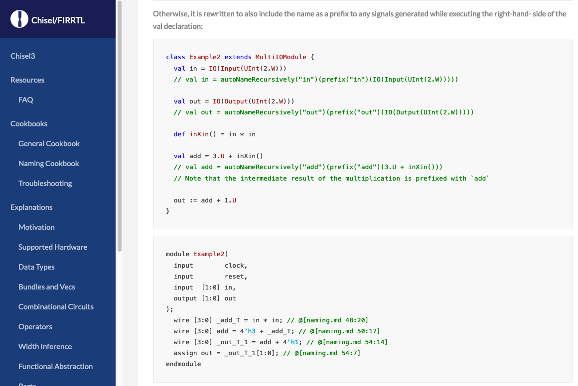
Further Improved Website
www.chisel-lang.org
Documentation examples are compiled and run!!!
36
4/19/22

Slide 37
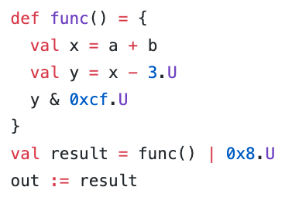
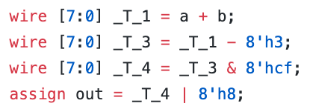
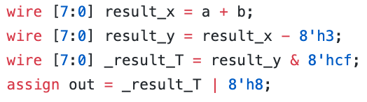
Enhanced Signal Naming (from last time)
Historically Chisel has struggled with signal naming
Chisel 3.4 has much better naming
Old* Verilog
Chisel 3.4 Verilog
Notes:
user control

Slide 38
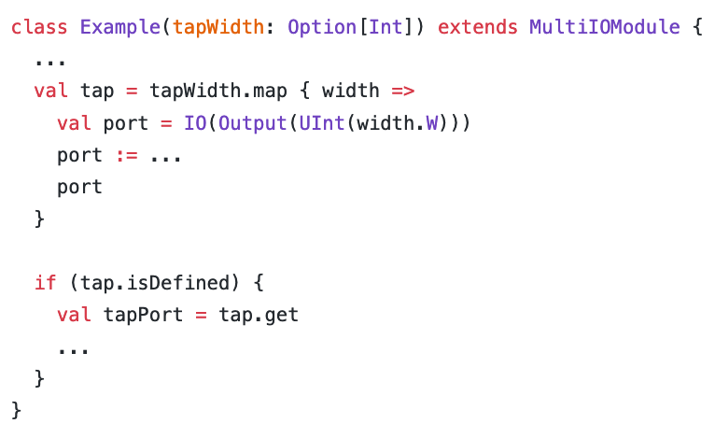
Refined Signal Naming
Optional “tap” output
What should the name of the port be?
port
tap_port
tap
tapPort
In 3.4.0, the name was ”tap_port”
In 3.4.1 on, the name is “tap”
Additional improvements to naming (especially when using recursion)
Now with ~5 months of use, it’s going great!
Notes:
user control, users are deleting their .suggestNames

Slide 39
Improved Release Methodology
3.2.0
3.2.1
3.2-SNAPSHOT
3.2.x
Backport
Backport
Backport
3.5-SNAPSHOT
major
major
major
master
Backport
3.3-SNAPSHOT
Automated Backporting + CI
3.3.0
3.3.x

